Slide 1
Presented By
Social Capital Analytics Challenge
Project Team
Sree Malya Bathina
Sbathina@memphis.edu
Babatunde Dallas
Bdallas@memphis.edu
Karthik Reddy Padidam kpadidam@memphis.edu
Raghuram Reddy Peddakapula Rpddkpla@memphis.edu
AMIS_1 Project Team

Slide 2

Microsoft Fabric Data Engineering
The actionable insight could enhance economic integration and uplift local communities in the USA at the State and County Levels.
Using Data Analytics and Machine Learning Techniques

Slide 3
This project aims to conduct a distributive analysis on how to enhance economic integration by uplifting local communities in USA at the State Level, using the Social Capital datasets.
The datasets provide measures of Social Capital for counties, ZIP codes, high schools, and colleges in the United States based on data from Facebook.
The datasets were developed from a collaboration result by Meta, Opportunity Insights, and researchers from Harvard, New York University, and Stanford.
The datasets are available on the Humanitarian Data Exchange website: https://data.humdata.org/dataset/social-capital-atlas.
The website is managed by the United Nations Office for the coordination of Humanitarian Adairs (OCHA) and is focused on increasing the use and impact of data in the humanitarian sector.
Addition dataset for state name was download on Simple Maps website: https://simplemaps.com/data/us-zips
Introduction
Notes:
Social Capital I: Measurement and Associations with Economic Mobility. Nature 608 (7921): 108-121, 2022.
Social Capital II: Determinants of Economic Connectedness. Nature 608 (7921): 122-134, 2022.
Authors:
Chetty, Raj, Matthew O. Jackson, Theresa Kuchler, Johannes Stroebel, Nathaniel Hendren, Robert Fluegge, Sara Gong, Federico Gonzalez, Armelle Grondin, Matthew Jacob, Drew Johnston, Martin Koenen, Eduardo Laguna-Muggenberg, Florian Mudekereza, Tom Rutter, Nicolaj Thor, Wilbur Townsend, Ruby Zhang, Mike Bailey, Pablo Barber ́a, Monica Bhole, and Nils Wernerfelt (2022a).

Slide 4
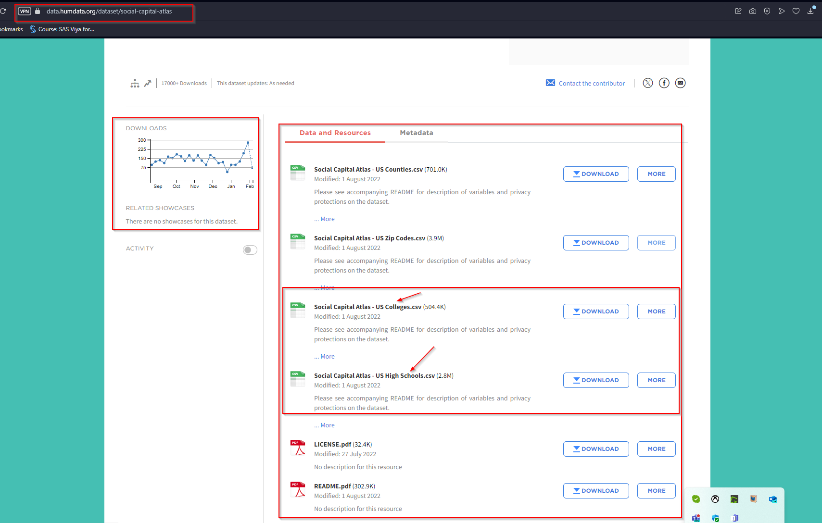
DATA
SOURCE
Notes:
Social Capital I: Measurement and Associations with Economic Mobility. Nature 608 (7921): 108-121, 2022.
Social Capital II: Determinants of Economic Connectedness. Nature 608 (7921): 122-134, 2022.
Authors:
Chetty, Raj, Matthew O. Jackson, Theresa Kuchler, Johannes Stroebel, Nathaniel Hendren, Robert Fluegge, Sara Gong, Federico Gonzalez, Armelle Grondin, Matthew Jacob, Drew Johnston, Martin Koenen, Eduardo Laguna-Muggenberg, Florian Mudekereza, Tom Rutter, Nicolaj Thor, Wilbur Townsend, Ruby Zhang, Mike Bailey, Pablo Barber ́a, Monica Bhole, and Nils Wernerfelt (2022a).

Slide 5
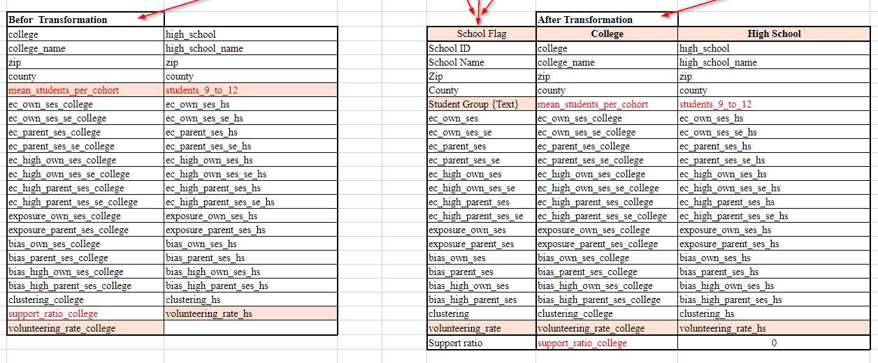
DATA TRANSFORMATION APPROACH

Slide 6
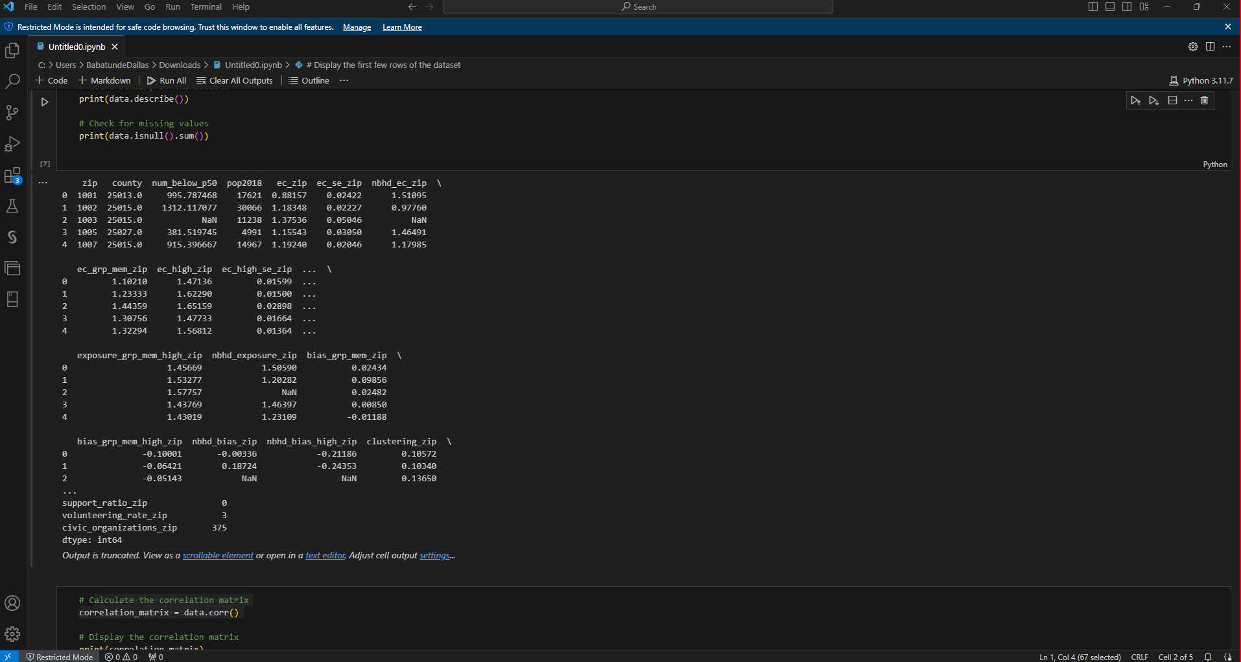
Data Analysis

Slide 7
Factors Influencing Social Connectedness
nbhd_exposure_zip: Correlation coefficient of 0.93, indicating a very strong positive relationship with neighborhood economic connectedness.
ec_grp_mem_zip: Correlation coefficient of 0.92, showing that economic connectedness within groups is a major factor in overall neighborhood economic connectedness.
ec_zip: Correlation coefficient of 0.86, highlighting the importance of general economic connectedness at the zip code level.
bias_grp_mem_zip: Negative correlation of -0.59, indicating that biases in group membership can hinder economic connectedness.
num_below_p50: Negative correlation of -0.35, showing that economic disparities, such as poverty and inequality, are barriers to social cohesion.

Slide 8
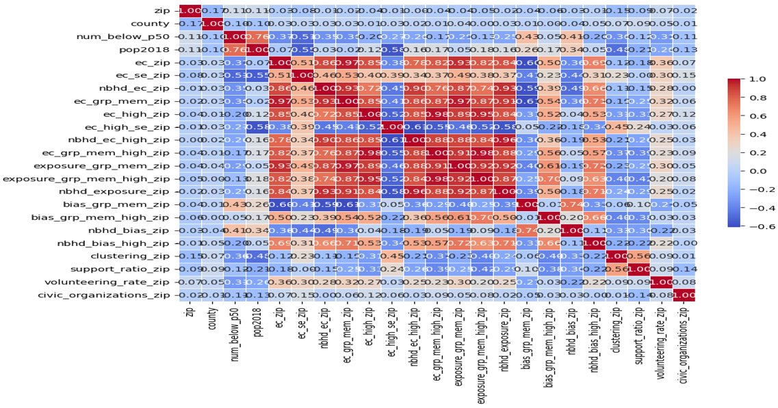
Confusion Matrix:

Slide 9
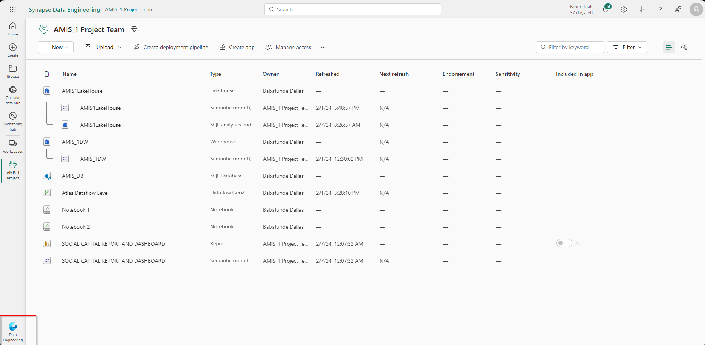
Microsoft Environment

Slide 10
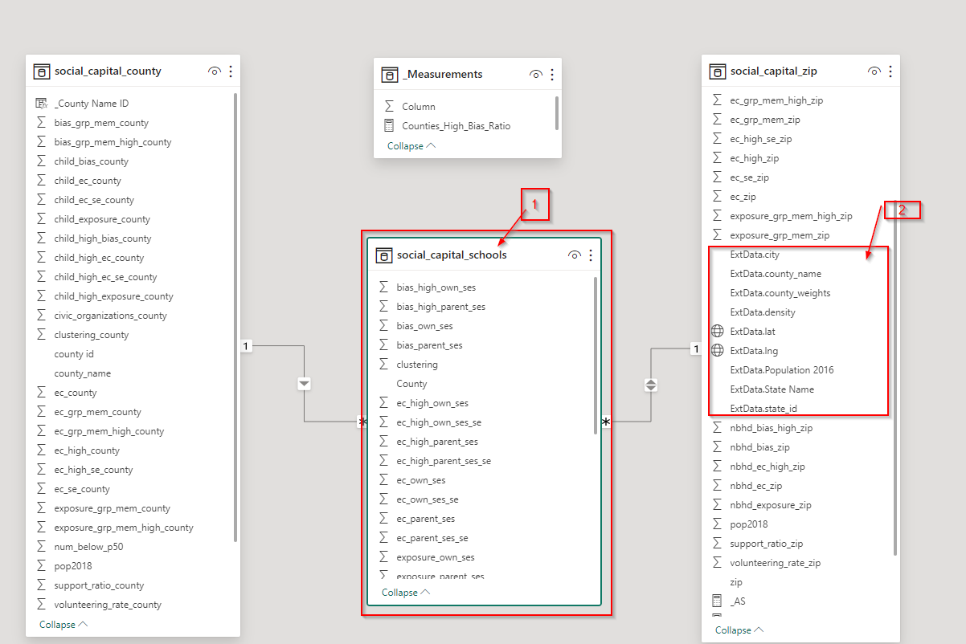
ERD
DATA MODEL OVERVIEW

Slide 11
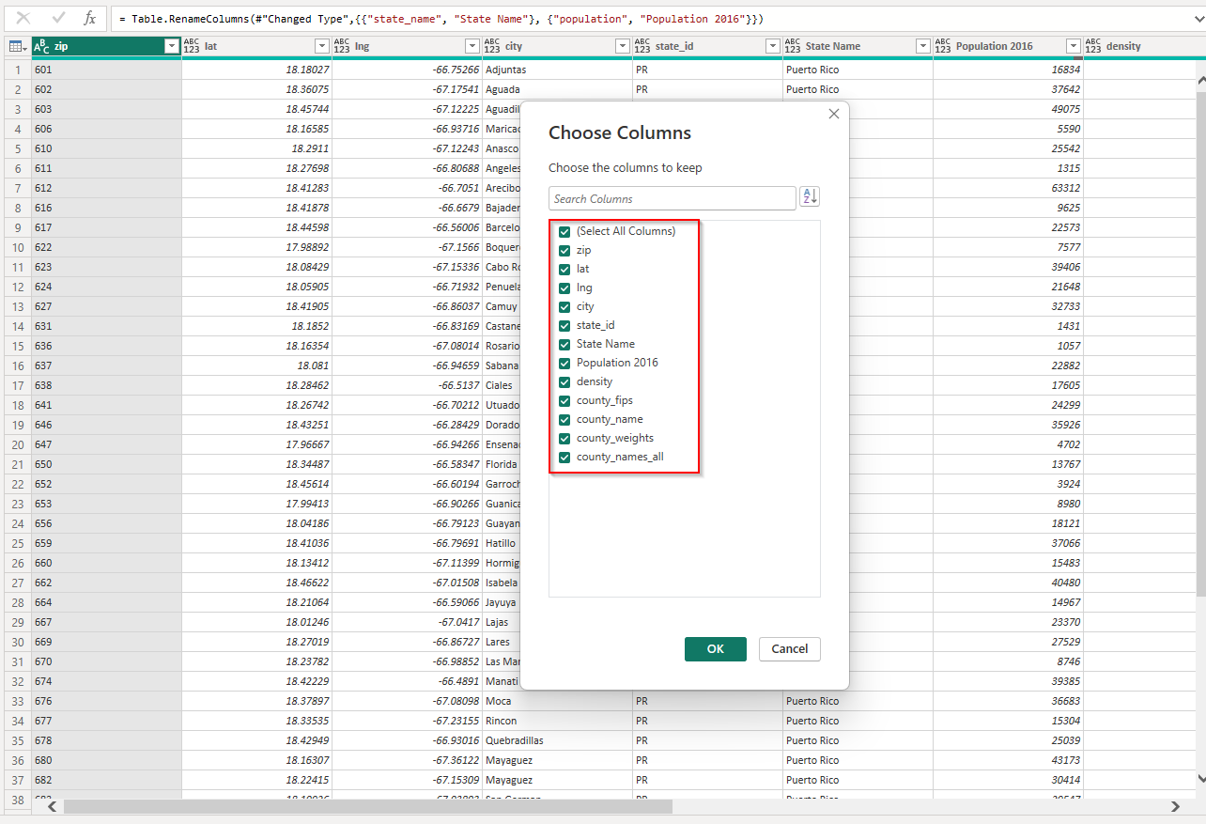
Addition dataset for state name was download on Simple Maps website: https://simplemaps.com/data/us-zips
EXTERNAL DATA SOURCE

Slide 12
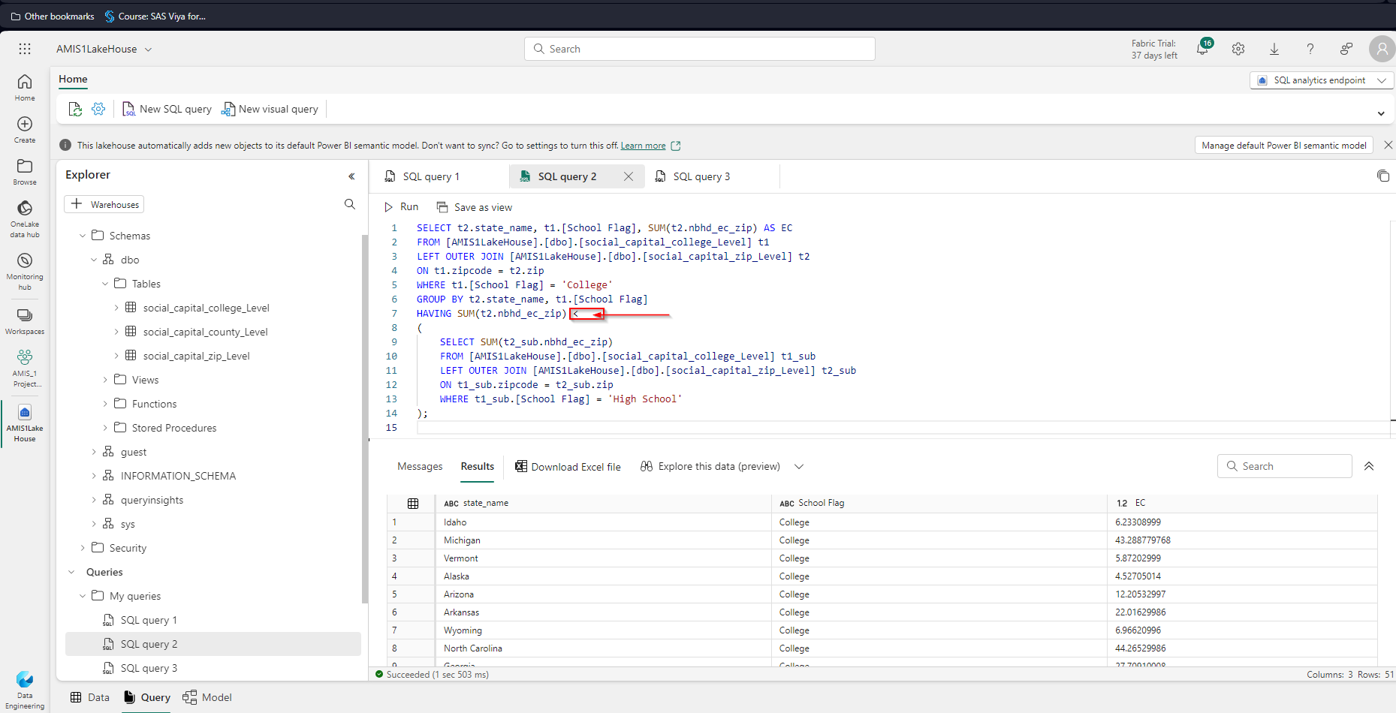
Data Exploration

Slide 13
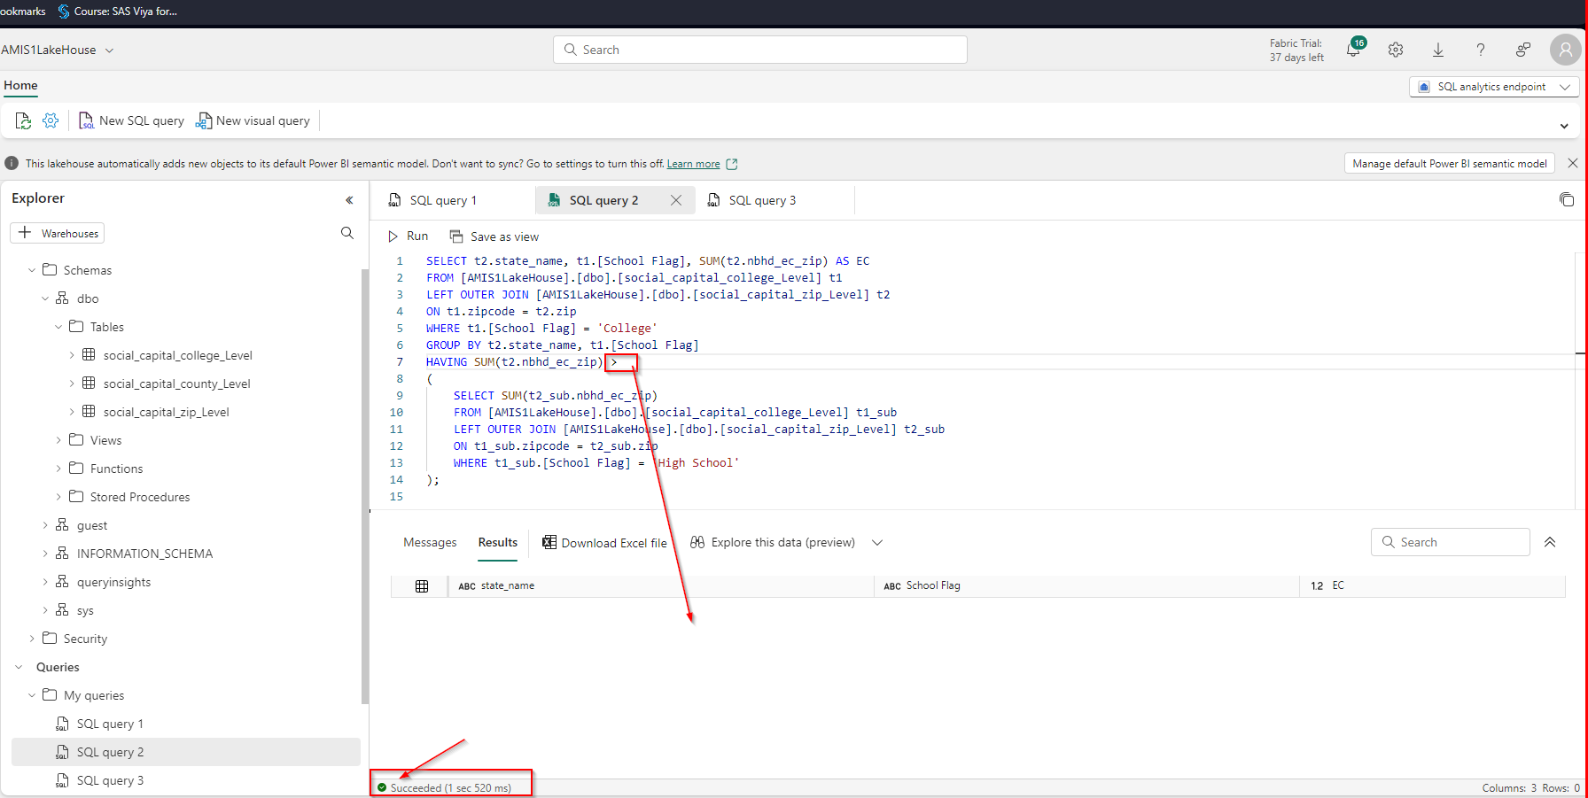
Data Exploration

Slide 14

Brainstorming
Our observation reveals that while economic connectedness is prominent in High schools, it diminishes in colleges.
We are interested in finding what factors contribute to this decline and why this fervor isn't being sustained.

Slide 15
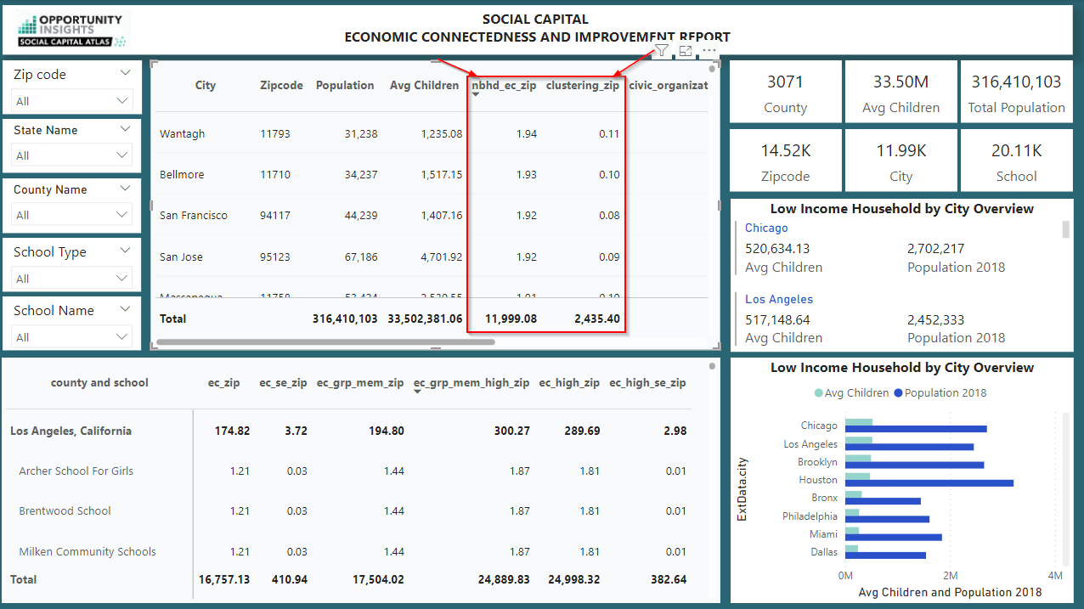

Slide 16
FOCUS
We focus on Economic connectedness Metrics within the friendly neighborhood (nbhd_ec_zip) and the Clustering Metrics (clustering_zip) at the local community using zip code.
nbhd_ec_zip refers to the ranking calculated metrics of friendly neighborhoods between 0 and 1.94. The higher the metrics indicate friendly neighborhoods in all local communities across the USA.
clustering_zip refers to the average fraction of friendly people who are also friends.
The higher the metrics in both Variable indicate a friendly neighborhood and vice versa.
Focusing on the lower indicator metrics can significantly impact economic integration and uplift communities because nbhd_ec_zip focuses on economic diversity within a neighborhood’s social network, and clustering_zip measures how interconnected an individual’s friends are.

Slide 17
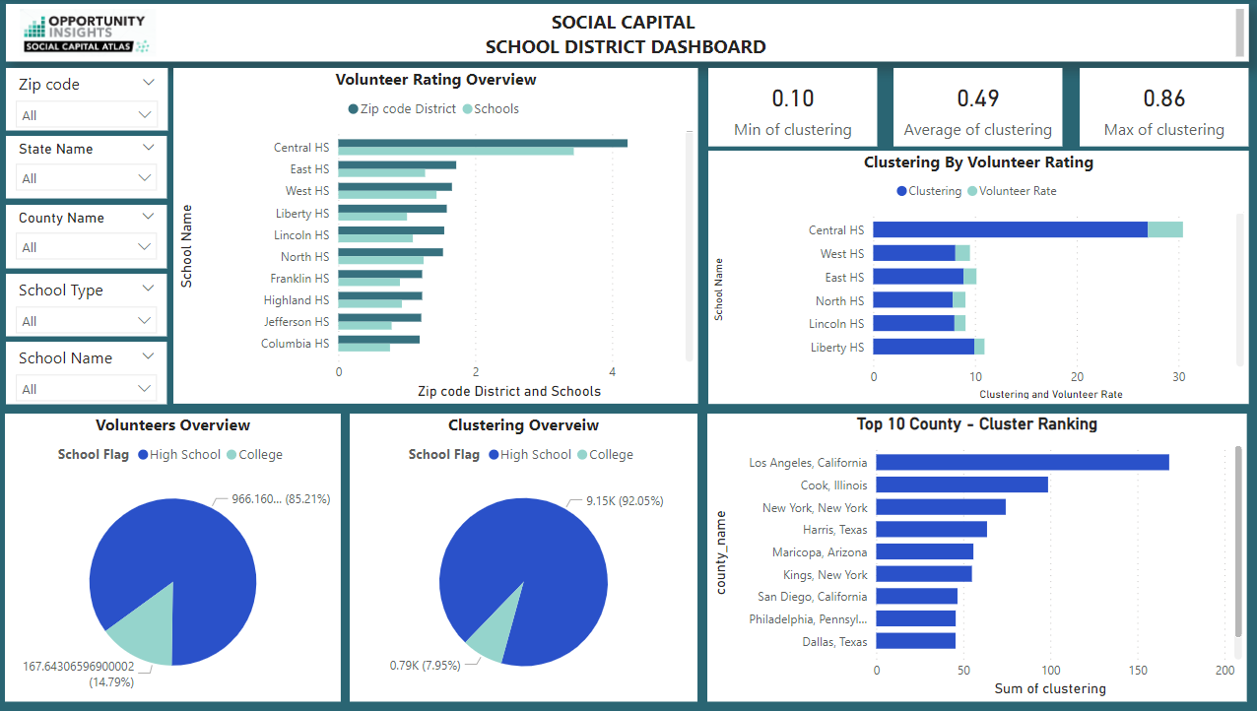

Slide 18

Actionable Steps to Enhance Social Connectedness
Implement community programs to facilitate interactions between different economic groups.
Support local organizations that promote economic collaboration and social support within communities.
Develop targeted interventions like job training programs and financial literacy education to reduce economic disparities
Encourage inclusive policies in local organizations to ensure equitable opportunities for economic connectedness.

Slide 19
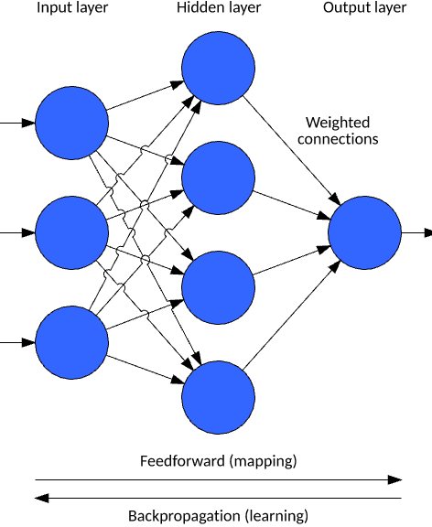
Future Modeling Approaches for Accurate Predictions
Utilize Hybrid Models like Ensemble Methods to enhance prediction accuracy by combining strengths of different algorithms.
Incorporate Deep Learning Techniques, such as Neural Networks and CNNs, for capturing complex data patterns and spatial relationships.
Apply Natural Language Processing (NLP) for sentiment analysis and topic modeling to understand community issues and social cohesion

Slide 20

Recommendations
Develop an interactive dashboard to visualize social capital impact from community initiatives, incorporating sentiment analysis, event participation rates, and economic indicators.
Create a decentralized blockchain-based social currency platform to assign value to community engagement and social impact, incentivizing participation in local events and collaborations.
Integrate an AI-powered community concierge service to provide personalized support, offering recommendations for events, economic opportunities, and social activities based on individual preferences.

Slide 21




Thank you !
Visual Studio Web
Github
Azure Dev Ops
Data Lake

